Slide 1
Prim’s Algorithm
∞
MST-Prim(G, w, r)
Q = V[G];
for each u ∈ Q
key[u] = ∞;
key[r] = 0;
p[r] = NULL;
while (Q not empty)
u = ExtractMin(Q);
for each v ∈ Adj[u]
if (v ∈ Q and w(u,v) < key[v])
p[v] = u;
key[v] = w(u,v);
6
4
5
9
∞
∞
∞
14
2
10
15
r
0
∞
∞
3
∞
8
Pick a start vertex r

Slide 2
Prim’s Algorithm
∞
MST-Prim(G, w, r)
Q = V[G];
for each u ∈ Q
key[u] = ∞;
key[r] = 0;
p[r] = NULL;
while (Q not empty)
u = ExtractMin(Q);
for each v ∈ Adj[u]
if (v ∈ Q and w(u,v) < key[v])
p[v] = u;
key[v] = w(u,v);
6
4
5
9
∞
∞
∞
14
2
10
15
u
0
∞
∞
3
∞
8
Blue vertices have been removed from Q

Slide 3
Prim’s Algorithm
MST-Prim(G, w, r)
Q = V[G];
for each u ∈ Q
key[u] = ∞;
key[r] = 0;
p[r] = NULL;
while (Q not empty)
u = ExtractMin(Q);
for each v ∈ Adj[u]
if (v ∈ Q and w(u,v) < key[v])
p[v] = u;
key[v] = w(u,v);
6
∞
4
5
9
∞
∞
∞
14
2
10
15
u
0
∞
∞
3
3
8
Arrows indicate parent pointers

Slide 4
Prim’s Algorithm
∞
MST-Prim(G, w, r)
Q = V[G];
for each u ∈ Q
key[u] = ∞;
key[r] = 0;
p[r] = NULL;
while (Q not empty)
u = ExtractMin(Q);
for each v ∈ Adj[u]
if (v ∈ Q and w(u,v) < key[v])
p[v] = u;
key[v] = w(u,v);
6
4
5
9
14
∞
∞
14
2
10
15
u
0
∞
∞
3
3
8

Slide 5
Prim’s Algorithm
∞
MST-Prim(G, w, r)
Q = V[G];
for each u ∈ Q
key[u] = ∞;
key[r] = 0;
p[r] = NULL;
while (Q not empty)
u = ExtractMin(Q);
for each v ∈ Adj[u]
if (v ∈ Q and w(u,v) < key[v])
p[v] = u;
key[v] = w(u,v);
6
4
5
9
14
∞
∞
14
2
10
15
0
∞
∞
3
3
8
u

Slide 6
Prim’s Algorithm
∞
MST-Prim(G, w, r)
Q = V[G];
for each u ∈ Q
key[u] = ∞;
key[r] = 0;
p[r] = NULL;
while (Q not empty)
u = ExtractMin(Q);
for each v ∈ Adj[u]
if (v ∈ Q and w(u,v) < key[v])
p[v] = u;
key[v] = w(u,v);
6
4
5
9
14
∞
∞
14
2
10
15
0
8
∞
3
3
8
u

Slide 7
Prim’s Algorithm
∞
MST-Prim(G, w, r)
Q = V[G];
for each u ∈ Q
key[u] = ∞;
key[r] = 0;
p[r] = NULL;
while (Q not empty)
u = ExtractMin(Q);
for each v ∈ Adj[u]
if (v ∈ Q and w(u,v) < key[v])
p[v] = u;
key[v] = w(u,v);
6
4
5
9
10
∞
∞
14
2
10
15
0
8
∞
3
3
8
u

Slide 8
Prim’s Algorithm
∞
MST-Prim(G, w, r)
Q = V[G];
for each u ∈ Q
key[u] = ∞;
key[r] = 0;
p[r] = NULL;
while (Q not empty)
u = ExtractMin(Q);
for each v ∈ Adj[u]
if (v ∈ Q and w(u,v) < key[v])
p[v] = u;
key[v] = w(u,v);
6
4
5
9
10
∞
∞
14
2
10
15
0
8
∞
3
3
8
u

Slide 9
Prim’s Algorithm
∞
MST-Prim(G, w, r)
Q = V[G];
for each u ∈ Q
key[u] = ∞;
key[r] = 0;
p[r] = NULL;
while (Q not empty)
u = ExtractMin(Q);
for each v ∈ Adj[u]
if (v ∈ Q and w(u,v) < key[v])
p[v] = u;
key[v] = w(u,v);
6
4
5
9
10
2
∞
14
2
10
15
0
8
∞
3
3
8
u

Slide 10
Prim’s Algorithm
∞
MST-Prim(G, w, r)
Q = V[G];
for each u ∈ Q
key[u] = ∞;
key[r] = 0;
p[r] = NULL;
while (Q not empty)
u = ExtractMin(Q);
for each v ∈ Adj[u]
if (v ∈ Q and w(u,v) < key[v])
p[v] = u;
key[v] = w(u,v);
6
4
5
9
10
2
∞
14
2
10
15
0
8
15
3
3
8
u

Slide 11
Prim’s Algorithm
∞
u
MST-Prim(G, w, r)
Q = V[G];
for each u ∈ Q
key[u] = ∞;
key[r] = 0;
p[r] = NULL;
while (Q not empty)
u = ExtractMin(Q);
for each v ∈ Adj[u]
if (v ∈ Q and w(u,v) < key[v])
p[v] = u;
key[v] = w(u,v);
6
4
5
9
10
2
∞
14
2
10
15
0
8
15
3
3
8

Slide 12
Prim’s Algorithm
∞
u
MST-Prim(G, w, r)
Q = V[G];
for each u ∈ Q
key[u] = ∞;
key[r] = 0;
p[r] = NULL;
while (Q not empty)
u = ExtractMin(Q);
for each v ∈ Adj[u]
if (v ∈ Q and w(u,v) < key[v])
p[v] = u;
key[v] = w(u,v);
6
4
5
9
10
2
9
14
2
10
15
0
8
15
3
3
8

Slide 13
Prim’s Algorithm
4
u
MST-Prim(G, w, r)
Q = V[G];
for each u ∈ Q
key[u] = ∞;
key[r] = 0;
p[r] = NULL;
while (Q not empty)
u = ExtractMin(Q);
for each v ∈ Adj[u]
if (v ∈ Q and w(u,v) < key[v])
p[v] = u;
key[v] = w(u,v);
6
4
5
9
10
2
9
14
2
10
15
0
8
15
3
3
8

Slide 14
Prim’s Algorithm
4
u
MST-Prim(G, w, r)
Q = V[G];
for each u ∈ Q
key[u] = ∞;
key[r] = 0;
p[r] = NULL;
while (Q not empty)
u = ExtractMin(Q);
for each v ∈ Adj[u]
if (v ∈ Q and w(u,v) < key[v])
p[v] = u;
key[v] = w(u,v);
6
4
5
9
5
2
9
14
2
10
15
0
8
15
3
3
8

Slide 15
Prim’s Algorithm
u
4
MST-Prim(G, w, r)
Q = V[G];
for each u ∈ Q
key[u] = ∞;
key[r] = 0;
p[r] = NULL;
while (Q not empty)
u = ExtractMin(Q);
for each v ∈ Adj[u]
if (v ∈ Q and w(u,v) < key[v])
p[v] = u;
key[v] = w(u,v);
6
4
5
9
5
2
9
14
2
10
15
0
8
15
3
3
8

Slide 16
Prim’s Algorithm
u
4
MST-Prim(G, w, r)
Q = V[G];
for each u ∈ Q
key[u] = ∞;
key[r] = 0;
p[r] = NULL;
while (Q not empty)
u = ExtractMin(Q);
for each v ∈ Adj[u]
if (v ∈ Q and w(u,v) < key[v])
p[v] = u;
key[v] = w(u,v);
6
4
5
9
5
2
9
14
2
10
15
0
8
15
3
3
8

Slide 17
Prim’s Algorithm
u
4
MST-Prim(G, w, r)
Q = V[G];
for each u ∈ Q
key[u] = ∞;
key[r] = 0;
p[r] = NULL;
while (Q not empty)
u = ExtractMin(Q);
for each v ∈ Adj[u]
if (v ∈ Q and w(u,v) < key[v])
p[v] = u;
key[v] = w(u,v);
6
4
5
9
5
2
9
14
2
10
15
0
8
15
3
3
8

Slide 18
Prim’s Algorithm
4
MST-Prim(G, w, r)
Q = V[G];
for each u ∈ Q
key[u] = ∞;
key[r] = 0;
p[r] = NULL;
while (Q not empty)
u = ExtractMin(Q);
for each v ∈ Adj[u]
if (v ∈ Q and w(u,v) < key[v])
p[v] = u;
key[v] = w(u,v);
6
4
5
9
5
2
9
14
2
u
10
15
0
8
15
3
3
8

Slide 19
Prim’s Algorithm
MST-Prim(G, w, r)
Q = V[G];
for each u ∈ Q
key[u] = ∞;
key[r] = 0;
p[r] = NULL;
while (Q not empty)
u = ExtractMin(Q);
for each v ∈ Adj[u]
if (v ∈ Q and w(u,v) < key[v])
p[v] = u;
key[v] = w(u,v);
What is the hidden cost in this code?

Slide 20
Prim’s Algorithm
MST-Prim(G, w, r)
Q = V[G];
for each u ∈ Q
key[u] = ∞;
key[r] = 0;
p[r] = NULL;
while (Q not empty)
u = ExtractMin(Q);
for each v ∈ Adj[u]
if (v ∈ Q and w(u,v) < key[v])
p[v] = u;
DecreaseKey(v, w(u,v));

Slide 21
Prim’s Algorithm
MST-Prim(G, w, r)
Q = V[G];
for each u ∈ Q
key[u] = ∞;
key[r] = 0;
p[r] = NULL;
while (Q not empty)
u = ExtractMin(Q);
for each v ∈ Adj[u]
if (v ∈ Q and w(u,v) < key[v])
p[v] = u;
DecreaseKey(v, w(u,v));
How often is ExtractMin() called?
How often is DecreaseKey() called?

Slide 22
Prim’s Algorithm
MST-Prim(G, w, r)
Q = V[G];
for each u ∈ Q
key[u] = ∞;
key[r] = 0;
p[r] = NULL;
while (Q not empty)
u = ExtractMin(Q);
for each v ∈ Adj[u]
if (v ∈ Q and w(u,v) < key[v])
p[v] = u;
key[v] = w(u,v);
What will be the running time? A: Depends on queue binary heap: O(E lg V) Fibonacci heap: O(V lg V + E)

Slide 23
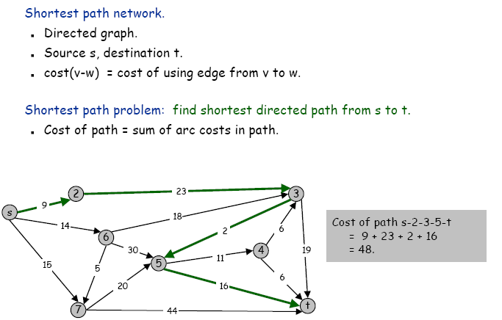
Shortest path problems

Slide 24
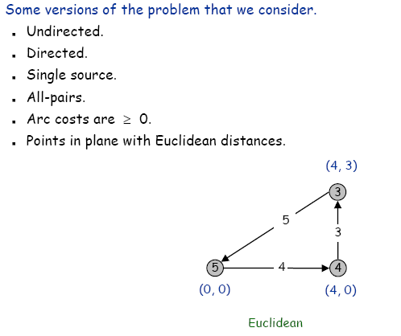
Shortest path problems

Slide 25
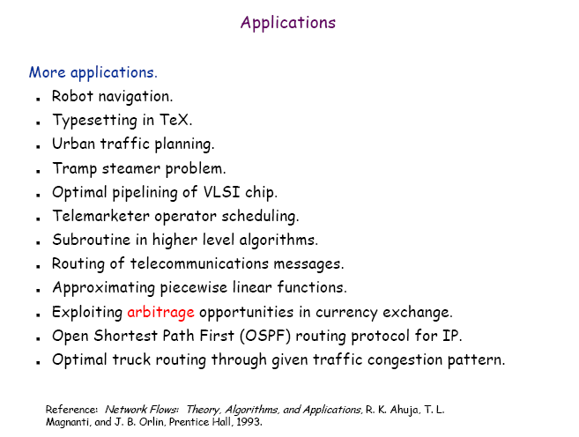
Shortest path problems

Slide 26
Single-Source Shortest Paths
Given graph (directed or undirected) G = (V,E) with weight function w: E → R and a vertex s∈V, find for all vertices v∈V the minimum possible weight for path from s to v.
We will discuss two general case algorithms:
Dijkstra's (positive edge weights only)
Bellman-Ford (positive end negative edge weights)
If all edge weights are equal (let's say 1), the problem
is solved by BFS in Θ(V+E) time.

Slide 27
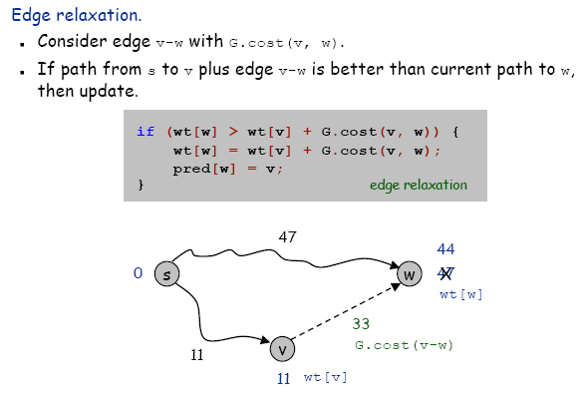


Dijkstra’s Algorithm - Relax
Relax(vertex u, vertex v, weight w)
if d[v] > d[u] + w(u,v) then
d[v] ← d[u] + w(u,v)
p[v] ← u

Slide 28
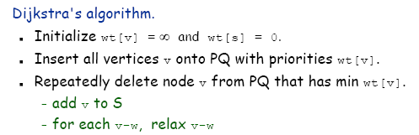
Dijkstra’s Algorithm - Idea

Slide 29
Dijkstra’s Algorithm - SSSP-Dijkstra
SSSP-Dijkstra(graph (G,w), vertex s)
InitializeSingleSource(G, s)
S ← ∅
Q ← V[G]
while Q ≠ 0 do
u ← ExtractMin(Q)
S ← S ∪ {u}
for v ∈ Adj[u] do
Relax(u,v,w)
InitializeSingleSource(graph G, vertex s)
for v ∈ V[G] do
d[v] ← ∞
p[v] ← 0
d[s] ← 0

Slide 30
Dijkstra’s Algorithm - Example
1
10
2
3
9
4
6
5
7
2

Slide 31
Dijkstra’s Algorithm - Example
1
∞
∞
10
2
3
9
0
4
6
5
7
∞
∞
2

Slide 32
Dijkstra’s Algorithm - Example
1
10
∞
10
2
3
9
0
4
6
5
7
5
∞
2

Slide 33
Dijkstra’s Algorithm - Example
1
10
∞
10
2
3
9
0
4
6
5
7
5
∞
2

Slide 34
Dijkstra’s Algorithm - Example
1
8
14
10
2
3
9
0
4
6
5
7
5
7
2

Slide 35
Dijkstra’s Algorithm - Example
1
8
14
10
2
3
9
0
4
6
5
7
5
7
2

Slide 36
Dijkstra’s Algorithm - Example
1
8
13
10
2
3
9
0
4
6
5
7
5
7
2

Slide 37
Dijkstra’s Algorithm - Example
1
8
13
10
2
3
9
0
4
6
5
7
5
7
2

Slide 38
Dijkstra’s Algorithm - Example
1
8
9
10
2
3
9
0
4
6
5
7
5
7
2

Slide 39
Dijkstra’s Algorithm - Example
1
8
9
10
2
3
9
0
4
6
5
7
5
7
2

Slide 40
Dijkstra’s Algorithm - Complexity
SSSP-Dijkstra(graph (G,w), vertex s)
InitializeSingleSource(G, s)
S ← ∅
Q ← V[G]
while Q ≠ 0 do
u ← ExtractMin(Q)
S ← S ∪ {u}
for u ∈ Adj[u] do
Relax(u,v,w)
executed Θ(V) times
Θ(E) times in total
InitializeSingleSource(graph G, vertex s)
for v ∈ V[G] do
d[v] ← ∞
p[v] ← 0
d[s] ← 0
Θ(V)
Relax(vertex u, vertex v, weight w)
if d[v] > d[u] + w(u,v) then
d[v] ← d[u] + w(u,v)
p[v] ← u
Θ(1) ?

Slide 41
Dijkstra’s Algorithm - Complexity
InitializeSingleSource T_{I}(V,E) = Θ(V)
Relax T_{R}(V,E) = Θ(1)?
SSSP-Dijkstra
T(V,E) = T_{I}(V,E) + Θ(V) + V Θ(log V) + E T_{R}(V,E) =
= Θ(V) + Θ(V) + V Θ(log V) + E Θ(1) = Θ(E + V log V)

Slide 42
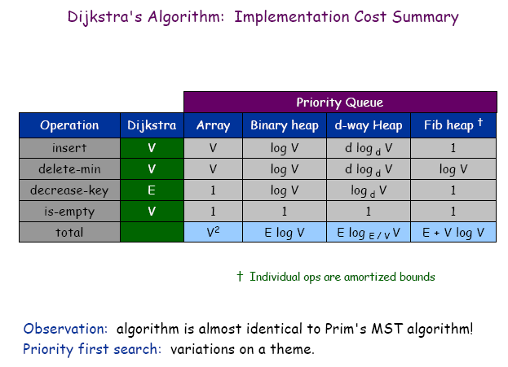
Dijkstra’s Algorithm - Complexity

Slide 43
Shortest Path Properties
Again, we have optimal substructure: the shortest path consists of shortest subpaths:
Proof: suppose some subpath is not a shortest path
There must then exist a shorter subpath
Could substitute the shorter subpath for a shorter path
But then overall path is not shortest path. Contradiction

Slide 44
Shortest Path Properties
Define δ(u,v) to be the weight of the shortest path from u to v
Shortest paths satisfy the triangle inequality: δ(u,v) ≤ δ(u,x) + δ(x,v)
“Proof”:
x
u
v
This path is no longer than any other path

Slide 45
Shortest Path Properties
In graphs with negative weight cycles, some shortest paths will not exist (Why?):
< 0

Slide 46
Relaxation
A key technique in shortest path algorithms is relaxation
Idea: for all v, maintain upper bound d[v] on δ(s,v)
Relax(u,v,w) {
if (d[v] > d[u]+w) then d[v]=d[u]+w;
}
5
2
9
5
2
6
Relax
Relax
5
2
7
5
2
6

Slide 47
Bellman-Ford Algorithm
BellmanFord()
for each v ∈ V
d[v] = ∞;
d[s] = 0;
for i=1 to |V|-1
for each edge (u,v) ∈ E
Relax(u,v, w(u,v));
for each edge (u,v) ∈ E
if (d[v] > d[u] + w(u,v))
return “no solution”;
Relax(u,v,w): if (d[v] > d[u]+w) then d[v]=d[u]+w
Initialize d[], which
will converge to shortest-path value δ
Relaxation: Make |V|-1 passes,
relaxing each edge
Test for solution Under what condition
do we get a solution?

Slide 48
Bellman-Ford Algorithm
BellmanFord()
for each v ∈ V
d[v] = ∞;
d[s] = 0;
for i=1 to |V|-1
for each edge (u,v) ∈ E
Relax(u,v, w(u,v));
for each edge (u,v) ∈ E
if (d[v] > d[u] + w(u,v))
return “no solution”;
Relax(u,v,w): if (d[v] > d[u]+w) then d[v]=d[u]+w
What will be the
running time?

Slide 49
Bellman-Ford Algorithm
BellmanFord()
for each v ∈ V
d[v] = ∞;
d[s] = 0;
for i=1 to |V|-1
for each edge (u,v) ∈ E
Relax(u,v, w(u,v));
for each edge (u,v) ∈ E
if (d[v] > d[u] + w(u,v))
return “no solution”;
Relax(u,v,w): if (d[v] > d[u]+w) then d[v]=d[u]+w
What will be the
running time?
A: O(VE)

Slide 50
Bellman-Ford Algorithm
BellmanFord()
for each v ∈ V
d[v] = ∞;
d[s] = 0;
for i=1 to |V|-1
for each edge (u,v) ∈ E
Relax(u,v, w(u,v));
for each edge (u,v) ∈ E
if (d[v] > d[u] + w(u,v))
return “no solution”;
Relax(u,v,w): if (d[v] > d[u]+w) then d[v]=d[u]+w
B
s
-1
2
A
2
E
3
1
4
-3
C
D
5
Ex: work on board

Slide 51
Bellman-Ford
Note that order in which edges are processed affects how quickly it converges
Correctness: show d[v] = δ(s,v) after |V|-1 passes
Lemma: d[v] ≥ δ(s,v) always
Initially true
Let v be first vertex for which d[v] < δ(s,v)
Let u be the vertex that caused d[v] to change: d[v] = d[u] + w(u,v)
Then d[v] < δ(s,v) δ(s,v) ≤ δ(s,u) + w(u,v) (Why?) δ(s,u) + w(u,v) ≤ d[u] + w(u,v) (Why?)
So d[v] < d[u] + w(u,v). Contradiction.

Slide 52
Bellman-Ford Algorithm - Example
-2
5
6
-3
8
-4
7
7
2
9

Slide 53
Bellman-Ford Algorithm - Example
-2
∞
5
∞
6
-3
8
0
7
-4
7
2
∞
9
∞

Slide 54
Bellman-Ford Algorithm - Example
-2
6
5
∞
6
-3
8
0
7
-4
7
2
7
9
∞

Slide 55
Bellman-Ford Algorithm - Example
-2
6
5
4
6
-3
8
0
7
-4
7
2
7
9
2

Slide 56
Bellman-Ford Algorithm - Example
-2
2
5
4
6
-3
8
0
7
-4
7
2
7
9
2

Slide 57
Bellman-Ford Algorithm - Example
-2
2
5
4
6
-3
8
0
7
-4
7
2
7
9
-2

Slide 58
Bellman-Ford Algorithm - Complexity
SSSP-BellmanFord(graph (G,w), vertex s)
InitializeSingleSource(G, s)
for i ← 1 to |V[G] − 1| do
for (u,v) ∈ E[G] do
Relax(u,v,w)
for (u,v) ∈ E[G] do
if d[v] > d[u] + w(u,v) then
return false
return true
executed Θ(V) times
Θ(E)
Θ(1)
Θ(E)

Slide 59
Bellman-Ford Algorithm - Complexity
InitializeSingleSource T_{I}(V,E) = Θ(V)
Relax T_{R}(V,E) = Θ(1)?
SSSP-BellmanFord
T(V,E) = T_{I}(V,E) + V E T_{R}(V,E) + E =
= Θ(V) + V E Θ(1) + E =
= Θ(V E)

Slide 60
Shortest Paths in DAGs - SSSP-DAG
SSSP-DAG(graph (G,w), vertex s)
topologically sort vertices of G
InitializeSingleSource(G, s)
for each vertex u taken in topologically sorted order do
for each vertex v ∈ Adj[u] do
Relax(u,v,w)

Slide 61
Shortest Paths in DAGs - Example
6
1
5
2
7
-1
-2
4
3
2

Slide 62
Shortest Paths in DAGs - Example
6
1
5
2
7
-1
-2
∞
0
∞
∞
∞
∞
4
3
2

Slide 63
Shortest Paths in DAGs - Example
6
1
5
2
7
-1
-2
∞
0
∞
∞
∞
∞
4
3
2

Slide 64
Shortest Paths in DAGs - Example
6
1
5
2
7
-1
-2
∞
0
∞
∞
∞
∞
4
3
2

Slide 65
Shortest Paths in DAGs - Example
6
1
5
2
7
-1
-2
∞
0
2
6
∞
∞
4
3
2

Slide 66
Shortest Paths in DAGs - Example
6
1
5
2
7
-1
-2
∞
0
2
6
6
4
4
3
2

Slide 67
Shortest Paths in DAGs - Example
6
1
5
2
7
-1
-2
∞
0
2
6
6
4
4
3
2

Slide 68
Shortest Paths in DAGs - Example
6
1
5
2
7
-1
-2
∞
0
2
6
5
4
4
3
2

Slide 69
Shortest Paths in DAGs - Example
6
1
5
2
7
-1
-2
∞
0
2
6
5
4
4
3
2

Slide 70
Shortest Paths in DAGs - Example
6
1
5
2
7
-1
-2
∞
0
2
6
5
3
4
3
2

Slide 71
Shortest Paths in DAGs - Example
6
1
5
2
7
-1
-2
∞
0
2
6
5
3
4
3
2

Slide 72
Shortest Paths in DAGs - Complexity
SSSP-DAG(graph (G,w), vertex s)
topologically sort vertices of G
InitializeSingleSource(G, s)
for each vertex u taken in topologically sorted order do
for each vertex v ∈ Adj[u] do
Relax(u,v,w)
T(V,E) = Θ(V + E) + Θ(V) + Θ(V) + E Θ(1) = Θ(V + E)

Slide 73
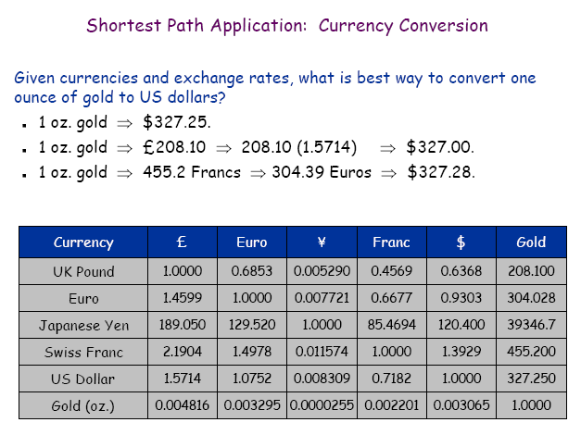
Application of SSSP - currency conversion

Slide 74
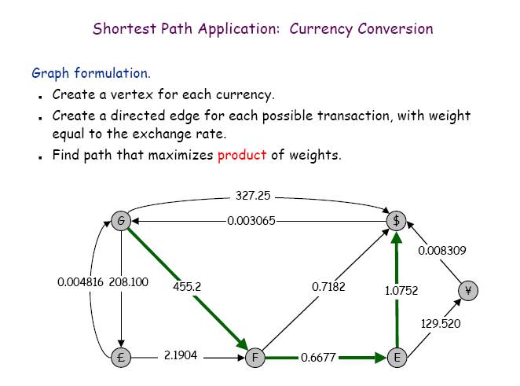
Application of SSSP - currency conversion

Slide 75
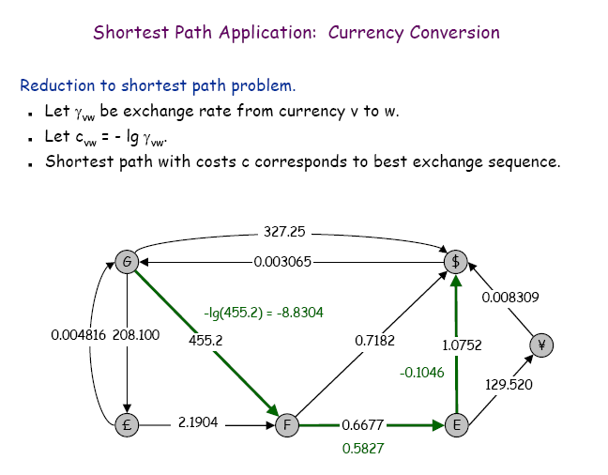
Application of SSSP - currency conversion

Slide 76
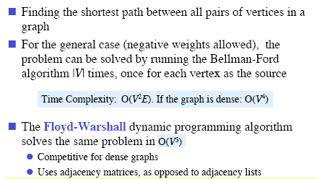
All-Pairs Shortest Paths
Given graph (directed or undirected) G = (V,E) with weight function w: E → R find for all pairs of vertices u,v ∈ V the minimum possible weight for path from u to v.

Slide 77
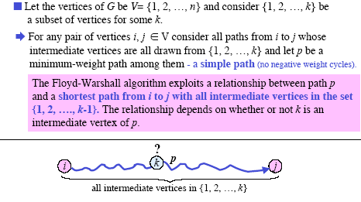
Floyd-Warshall Algorithm - Idea

Slide 78
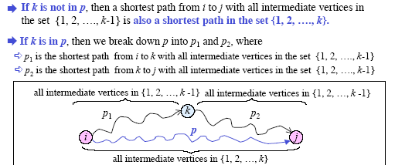
Floyd-Warshall Algorithm - Idea

Slide 79
Floyd-Warshall Algorithm - Idea
d_{s,t}^{(i)} – the shortest path from s to t containing only vertices
v₁, ..., v_{i}
d_{s,t}⁽⁰⁾ = w(s,t)
w(s,t) if k = 0
min{d_{s,t}^{(k-1)}, d_{s,k}^{(k-1)} + d_{k,t}^{(k-1)}} if k > 0
d_{s,t}^{(k)} =

Slide 80
Floyd-Warshall Algorithm - Algorithm
FloydWarshall(matrix W, integer n)
for k ← 1 to n do
for i ← 1 to n do
for j ← 1 to n do
d_{ij}^{(k)} ← min(d_{ij}^{(k-1)}, d_{ik}^{(k-1)} + d_{kj}^{(k-1)})
return D^{(n)}

Slide 81
Floyd-Warshall Algorithm - Example
W
3
2
4
7
1
0 | 3 | 8 | ∞ | -4
∞ | 0 | ∞ | 1 | 7
∞ | 4 | 0 | ∞ | ∞
2 | ∞ | -5 | 0 | ∞
∞ | ∞ | ∞ | 6 | 0
1
3
8
-4
2
-5
5
4
6

Slide 82
Floyd-Warshall Algorithm - Example
D⁽⁰⁾ Π⁽⁰⁾
0 | 3 | 8 | ∞ | -4
∞ | 0 | ∞ | 1 | 7
∞ | 4 | 0 | ∞ | ∞
2 | ∞ | -5 | 0 | ∞
∞ | ∞ | ∞ | 6 | 0
0 | 0 | 0 |  | 0
 | 0 |  | 0 | 0
 | 0 | 0
0 |  | 0 | 0
 |  |  | 0 | 0

Slide 83
Floyd-Warshall Algorithm - Example
D⁽¹⁾ Π⁽¹⁾
0 | 3 | 8 | ∞ | -4
∞ | 0 | ∞ | 1 | 7
∞ | 4 | 0 | ∞ | ∞
2 | 5 | -5 | 0 | -2
∞ | ∞ | ∞ | 6 | 0
0 | 0 | 0 |  | 0
 | 0 |  | 0 | 0
 | 0 | 0
0 | 1 | 0 | 0 | 1
 |  |  | 0 | 0

Slide 84
Floyd-Warshall Algorithm - Example
D⁽²⁾ Π⁽²⁾
0 | 3 | 8 | 4 | -4
∞ | 0 | ∞ | 1 | 7
∞ | 4 | 0 | 5 | 11
2 | 5 | -5 | 0 | -2
∞ | ∞ | ∞ | 6 | 0
0 | 0 | 0 | 2 | 0
 | 0 |  | 0 | 0
 | 0 | 0 | 2 | 2
0 | 1 | 0 | 0 | 1
 |  |  | 0 | 0

Slide 85
Floyd-Warshall Algorithm - Example
D⁽³⁾ Π⁽³⁾
0 | 3 | 8 | 4 | -4
∞ | 0 | ∞ | 1 | 7
∞ | 4 | 0 | 5 | 11
2 | -1 | -5 | 0 | -2
∞ | ∞ | ∞ | 6 | 0
0 | 0 | 0 | 2 | 0
 | 0 |  | 0 | 0
 | 0 | 0 | 2 | 2
0 | 3 | 0 | 0 | 1
 |  |  | 0 | 0

Slide 86
Floyd-Warshall Algorithm - Example
D⁽⁴⁾ Π⁽⁴⁾
0 | 3 | -1 | 4 | -4
3 | 0 | -4 | 1 | -1
7 | 4 | 0 | 5 | 3
2 | -1 | -5 | 0 | -2
8 | 5 | 1 | 6 | 0
0 | 0 | 4 | 2 | 0
4 | 0 | 4 | 0 | 1
4 | 0 | 0 | 2 | 1
0 | 3 | 0 | 0 | 1
4 | 3 | 4 | 0 | 0

Slide 87
Floyd-Warshall Algorithm - Example
D⁽⁵⁾ Π⁽⁵⁾
0 | 3 | -1 | 2 | -4
3 | 0 | -4 | 1 | -1
7 | 4 | 0 | 5 | 3
2 | -1 | -5 | 0 | -2
8 | 5 | 1 | 6 | 0
0 | 0 | 4 | 5 | 0
4 | 0 | 4 | 0 | 1
4 | 0 | 0 | 2 | 1
0 | 3 | 0 | 0 | 1
4 | 3 | 4 | 0 | 0

Slide 88
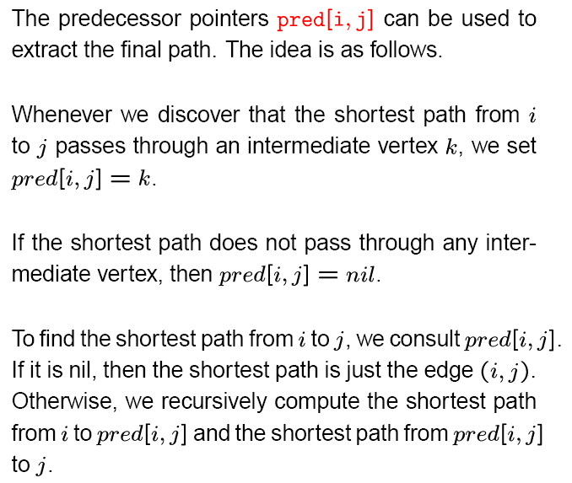
Floyd-Warshall Algorithm - Extracting the shortest paths

Slide 89
Floyd-Warshall Algorithm - Complexity
FloydWarshall(matrix W, integer n)
for k ← 1 to n do
for i ← 1 to n do
for j ← 1 to n do
d_{ij}^{(k)} ← min(d_{ij}^{(k-1)}, d_{ik}^{(k-1)} + d_{kj}^{(k-1)})
return D^{(n)}
3 for cycles, each executed exactly n times
T(V,E) = Θ(n³) = Θ(V³)

Slide 90
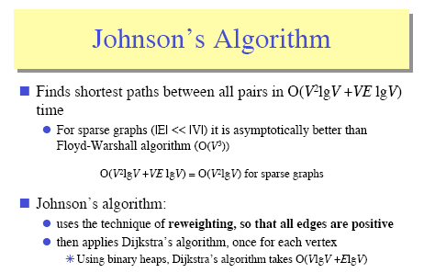
All-Pairs Shortest Paths -Johnson's algorithm

Slide 91
Johnson’s Algorithm
Makes clever use of Bellman-Ford and Dijkstra to do All-Pairs-Shortest-Paths efficiently on sparse graphs.
Motivation: By running Dijkstra |V| times, we could do APSP in time Θ(V²lgV +VElgV) (Modified Dijkstra), or Θ(V²lgV +VE) (Fibonacci Dijkstra). This beats Θ(V³) (Floyd-Warshall) when the graph is sparse.
Problem: negative edge weights.

Slide 92
The Basic Idea
Reweight the edges so that:
No edge weight is negative.
Shortest paths are preserved. (A shortest path in the original graph is still one in the new, reweighted graph.)
An obvious attempt: subtract the minimum weight from all the edge weights. E.g. if the minimum weight is -2:
-2 - -2 = 0
3 - -2 = 5
etc.

Slide 93
Counterexample
Subtracting the minimum weight from every weight doesn’t work.
Consider:
Paths with more edges are unfairly penalized.
-2
0
-2
-1
0
1

Slide 94
Johnson’s Insight
Add a vertex s to the original graph G, with edges of weight 0 to each vertex in G:
Assign new weights ŵ to each edge as follows:
ŵ(u, v) = w(u, v) + δ(s, u) - δ(s, v)
0
0
s
0

Slide 95
Question 1
Are all the ŵ’s non-negative? Yes:
Otherwise, s ⇒ u → v would be shorter than the shortest path from s to v.
δ(s, u)
u
s
w(u, v)
δ(s, v)
v

Slide 96
Question 2
Does the reweighting preserve shortest paths? Yes: Consider any path
the sum telescopes
A value that depends only on the endpoints, not on the path.
In other words, we have adjusted the lengths of all paths by the same amount. So this will not affect the relative ordering of the paths— shortest paths will be preserved.

Slide 97
Question 3
How do we compute the δ(s, v)’s?
Use Bellman-Ford.
This also tells us if we have a negative-weight cycle.

Slide 98
Johnson’s: Algorithm
Compute G’, which consists of G augmented with s and a zero-weight edge from s to every vertex in G.
Run Bellman-Ford(G’, w, s) to obtain the δ(s,v)’s
Reweight by computing ŵ for each edge
Run Dijkstra on each vertex to compute
Undo reweighting factors to compute δ

Slide 99
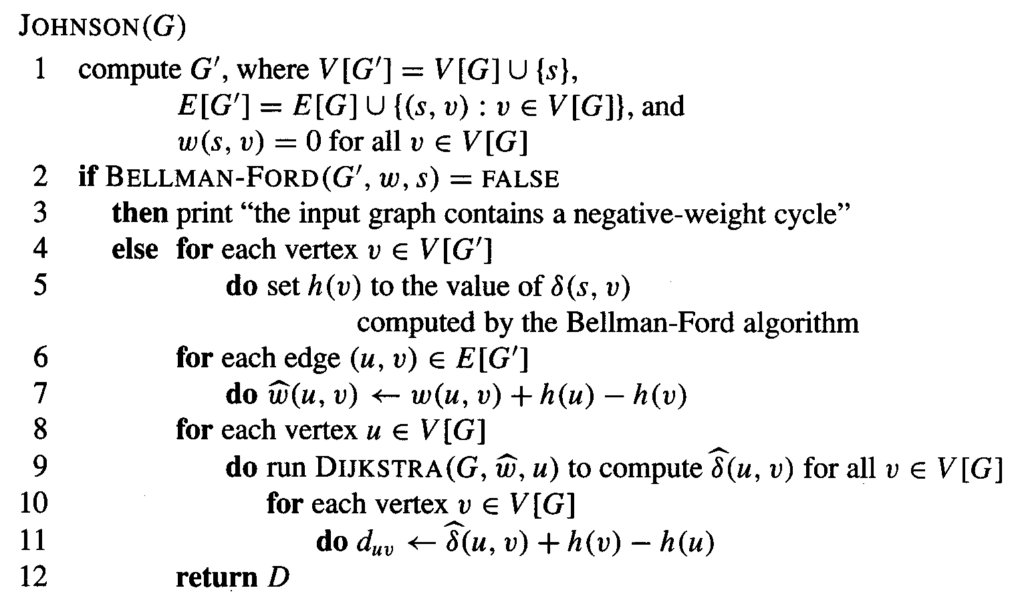
Johnson’s: CLRS

Slide 100
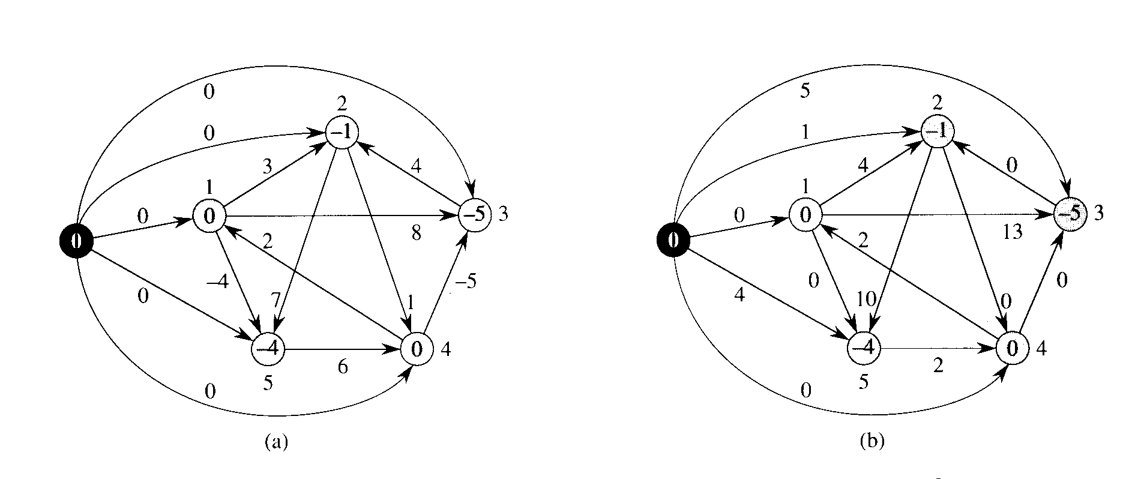
Johnson: reweighting
ŵ(u, v) = w(u, v) + d(s, u) - d(s, v)

Slide 101
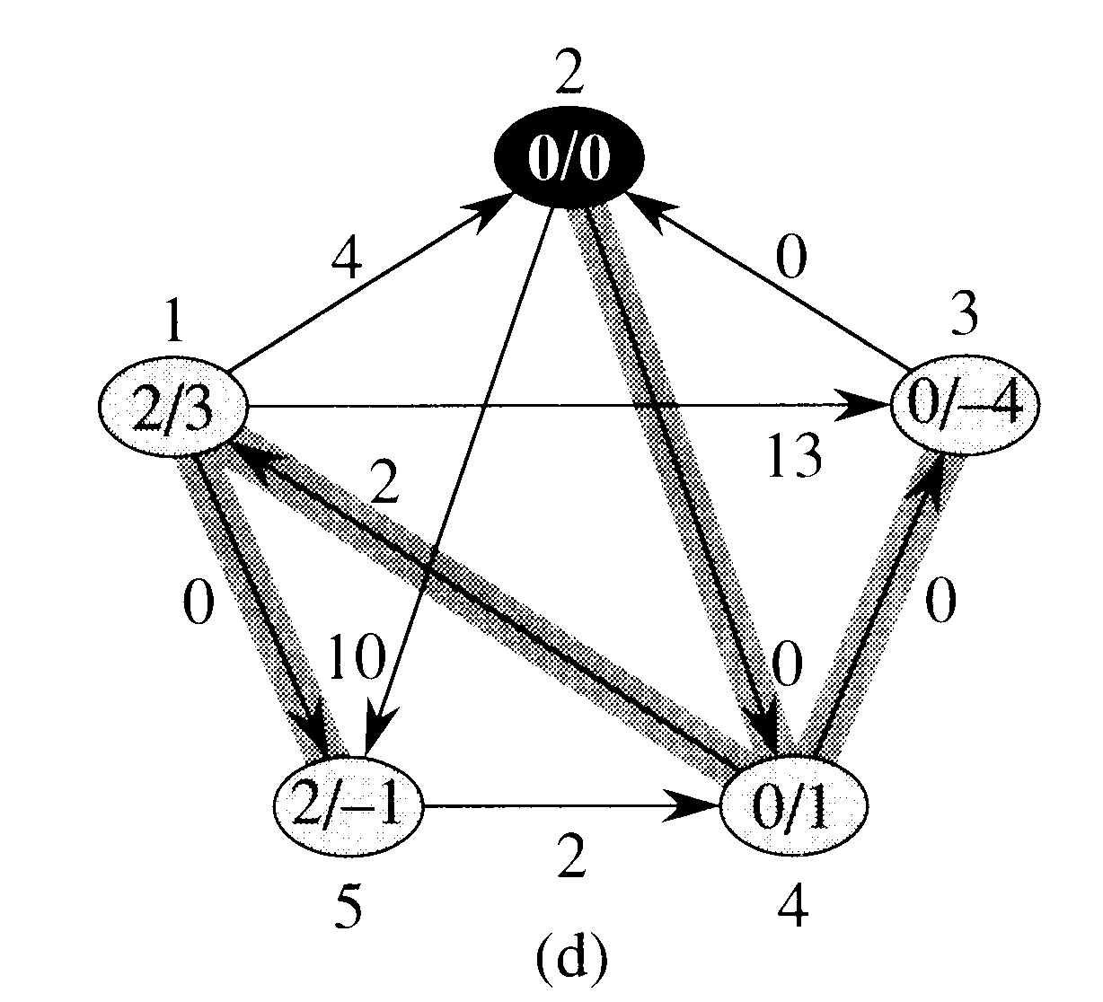
Johnson using Dijkstra

Slide 102
Johnson’s: Running Time
Computing G’: Θ(V)
Bellman-Ford: Θ(VE)
Reweighting: Θ(E)
Running (Modified) Dijkstra: Θ(V²lgV +VElgV)
Adjusting distances: Θ(V²)
Total is dominated by Dijkstra: Θ(V²lgV +VElgV)

